Slide 1



Content Performance

Slide 2


Today's agenda
Project recap
Problem
The Analytics Team
Process
Insights
Summary

Slide 3

Social Buzz, a social media and content creation company, located in San Francisco (USA) has recently reached out to us with 3 expectations :
An audit of their big data practice.
Recommendations for a successful IPO.
An analysis of their content categories that highlights the top 5 categories with the largest aggregate popularity .
Project Recap

Slide 4

Problem
Social Buzz, with over 500 million monthly active users, generates massive amounts of unstructured data including 100,000 daily content pieces. To manage and analyze this data, the company employs 200 technical staff out of a total of 250 employees.
Accenture's Analytics Team will analyze Social Buzz's content categories to identify top performers and provide data-driven insights for scaling the business.

Slide 5



Andrew Fleming (Chief Technical Architect)
The Analytics Team
Marcus Rompton (Senior Principle)
Sheersh Saxena (Data Analyst)

Slide 6

Process
1
Data Understanding
2
Data Cleaning
3
Data Modelling
4
Data Analysis
5
Getting the Insights

Slide 7


Insights
There are total 16 unique Content Categories present on Social Buzz platform
“Animals” is the top performing content category on Social Buzz with total 1897 reactions.
Maximum posts are made in the month of May.

Slide 8
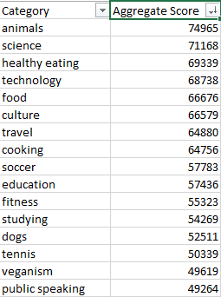
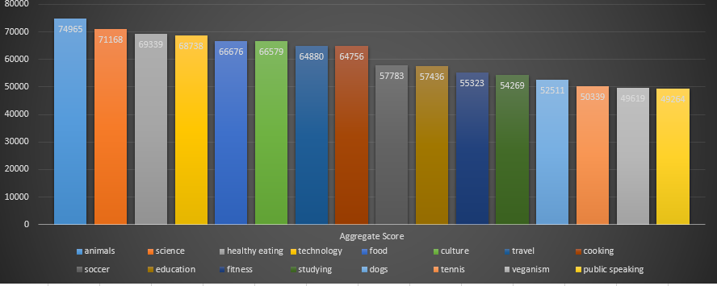
Top 5 Content Categories on Social Buzz platform are :
Animals
Science
Healthy Eating
Technology
Food

Slide 9
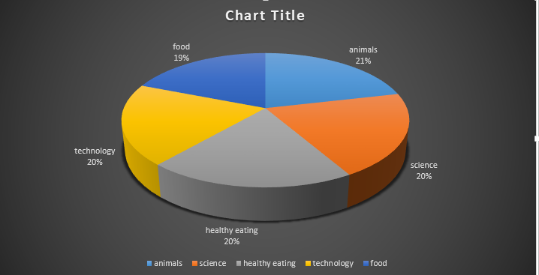
Popularity percentage share from top 5 content categories

Slide 10
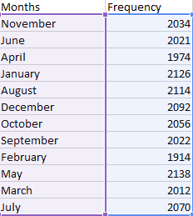
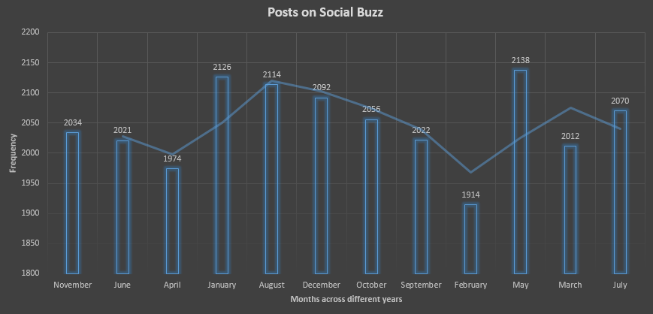

Top 3 MONTHS WITH MAXIMUM NUMBER OF POSTS:
May
January
August

Slide 11
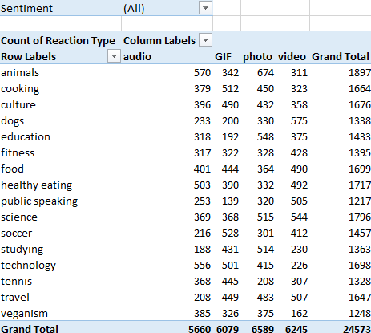
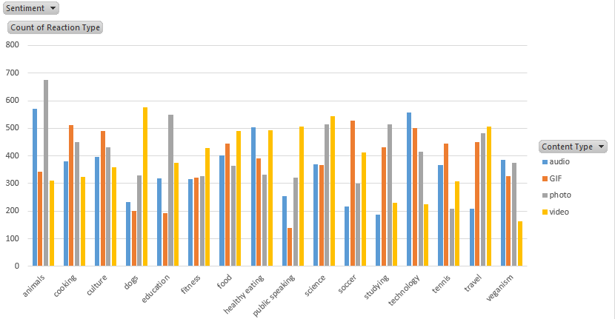
Top 3 Content Categories on which people reacted the most:
Animals
Science
Healthy Eating

Slide 12
Which Content Type dominates which Content Category:
Audio : Most popular audio clippings are of : Animals, Technology, Healthy Eating.
GIF : Graphical Interchange Format is mostly used for content related to Soccer, Cooking, Technology, Culture.
Photos : Most popular photos on Social Buzz are of Animals, Education, Science and Studying.
Video : Top categories in this segment are Dogs, Science, Travel, Public Speaking.

Slide 13
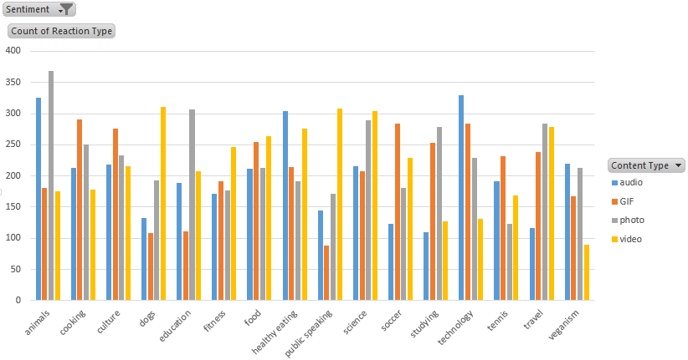
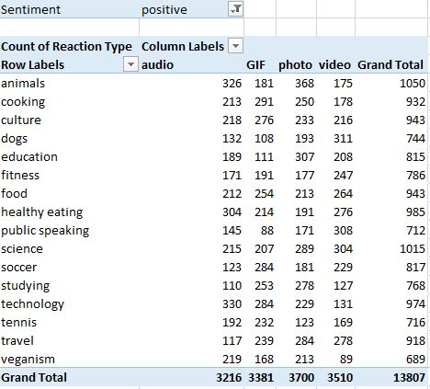
Top 3 Content Categories that were served with positive reactions :
Animals
Science
Healthy Eating

Slide 14
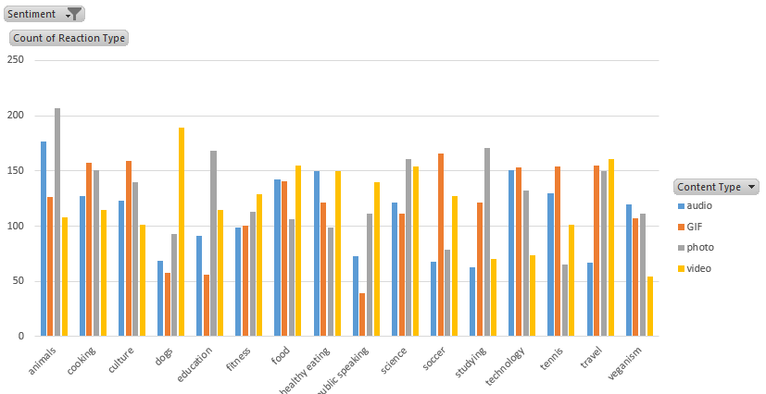
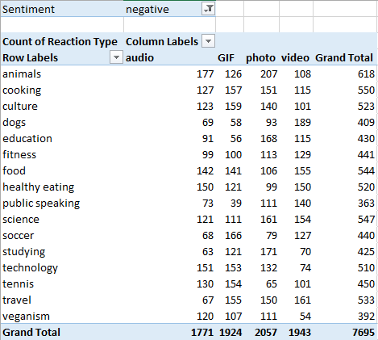
Top 3 Content Categories that faced negative reactions from the public:
Animals
Cooking
Science

Slide 15


Summary
May, January, August, December are the months where traffic is huge on the platform. Whereas in the month of February and April traffic is usually less. Hence more ad-campaigns during high traffic months can generate more revenue.
Animals, Science are the most popular content category on the platform, shows that people love “real life“ and “factual” content the most.
Next step:
This ad-hoc analysis is insightful, but it’s time to take this analysis into large scale production for real-time understanding of your business.
We can show you how to do this.

Slide 16

Thank you!
ANY QUESTIONS?

